Slide 1
HR Analytics
EMPLOYEE RETENTION

Slide 2
Project Name :
HR Analytics - Employee Retention
Mentor : Shruti Nigam

Slide 3
Project Member :
Pawan Kumar Paswan
Payal Sharma
Nihal K R
Aditya Girish Pagare
Gayatri Gaonkar

Slide 4
AGENDA
Introduction & Problem Statement
About Dataset
Business Objective
KPIS
Dashboard
Conclusion

Slide 5
INTRODUCTION & PROBLEM STATEMENT
HR analytics involves the collection and analysis of HR-related data, including employee data, performance metrics, and other relevant data points. By using advanced analytical tools and techniques, HR analytics provides valuable insights into HR processes and trends, enabling organizations to make more informed decisions about their employees and improve overall performance.

Slide 6
About Dataset
Domain : HR Analytics
Project Name: Employee Retention
Dataset Name: HR_1 & HR_2
Dataset Type: Excel Data
Dataset Size: 50k records each
HR_1 and HR_2 both have 18 columns respectively

Slide 7
BUSINESS OBJECTIVE
The main objective is to retain the employees of the organization
Employee Attrition is unpleasant to any organization
The main objective is to reduce attrition rate of the organization using Analytical methods
Analytics can help the organizations to control the employee Attrition Rate

Slide 8
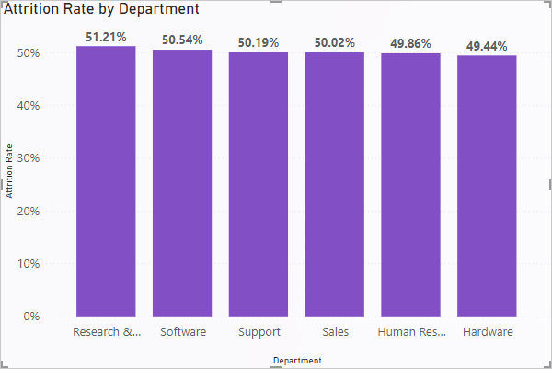
KPI 1 : Average Attrition rate for all Departments
This KPI is to find out the relationship between each department and its attrition rate and here attrition rate is highest for Research & Development Department whereas lowest is for Hardware Department.

Slide 9
Insights from KPI 1 :
We can clearly say that attrition rate of employees for every department is almost 50% which indicates that attrition rate of employees does not depends on department. So, irrespective of the department almost 50% of employees are leaving the company.
From this calculation and visualization we concluded that we must make strong strategies to minimize attrition rate and improve our company’s Employee retention so that we can balance the company’s growth and right talent.

Slide 10
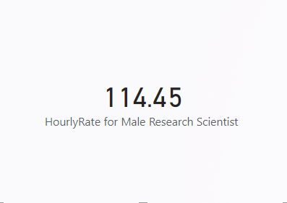
KPI 2 : Average Hourly rate of Male Research Scientist
Insights from KPI 2 :
This KPI is to find out the average hourly rate of male research scientists which is 114.45.

Slide 11
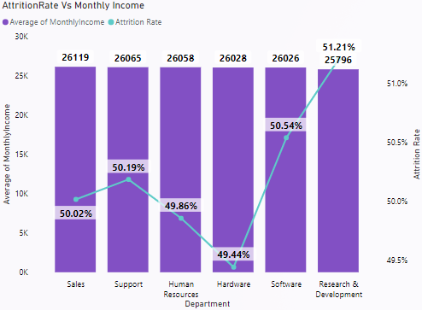
KPI 3 : Attrition rate Vs Monthly income stats
This KPI is to find out the relation the between monthly income and Attrition rate.

Slide 12
Insights from KPI 3 :
Based on our analysis and visualization, it is evident that the Hardware Department has the lowest attrition rate of 49.44%, with an average monthly income of Rs. 26,028. On the other hand, the Research and Development Department has the highest attrition rate of 51.21%, with an average monthly income of Rs. 25,796.
From this visualization we can conclude that due to low average monthly income attrition rate is high.

Slide 13
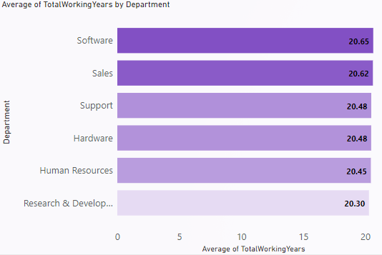
KPI 4 : Average working years for each Department
From this we can see the average working years in software department is high as compared to the rest of the departments and lowest is for Research & Development Department
From the analysis we can conclude that average working years is approximately 20 for all the departments.

Slide 14
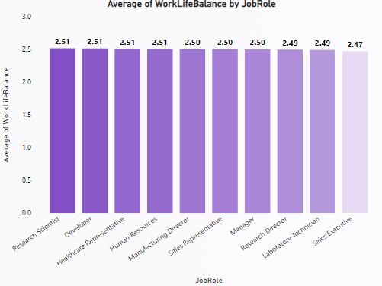
KPI 5 : Job Role Vs Work life balance
From the analysis we can conclude that,
For Research Scientist, Developer, Healthcare Representative & Human Resources the work life balance is Good.
For Sales Executive the work life balance is very poor and rest of the department the work life balance is fair.
Due to low work life balance may leads to increase attrition rate.

Slide 15
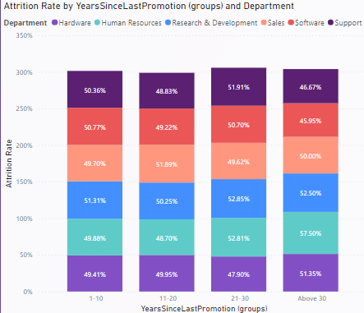
KPI 6 : Attrition rate Vs Year since last promotion relation
This KPI is to find out the relation the between Attrition rate and Year Since Last Promotion.

Slide 16
Insights from KPI 6 :
From the analysis and Visualisation
For 1-10 years since Last year Promotion interval Research & Development and Hardware departments has highest and lowest attrition rate respectively.
For 11-20 years since Last year Promotion interval Sales and Human Resources departments has highest and lowest attrition rate respectively.
For 21-30 years since Last year Promotion interval Research & Development and Hardware departments has highest and lowest attrition rate respectively.
For Above 30 years since Last year Promotion interval Human Resources and Software departments has highest and lowest attrition rate respectively.

Slide 17
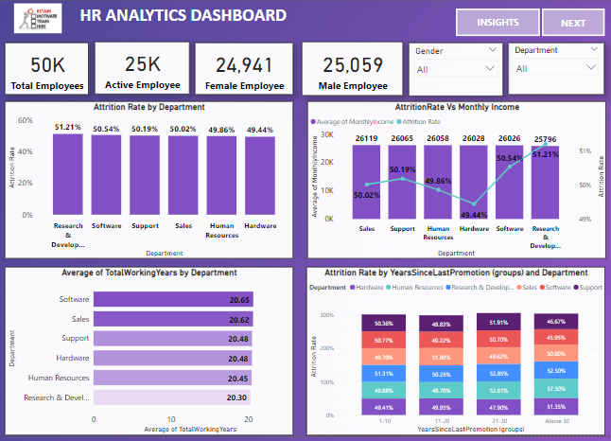
HR ANALYTICS DASHBOARD

Slide 18
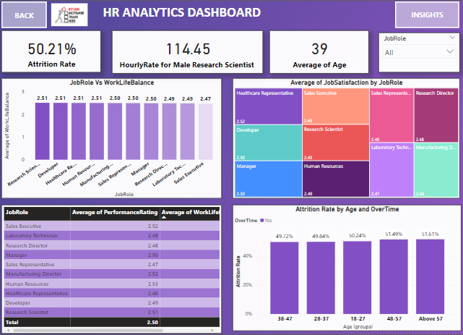

Slide 19
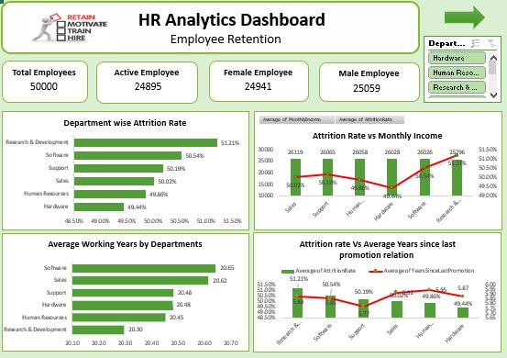

Slide 20
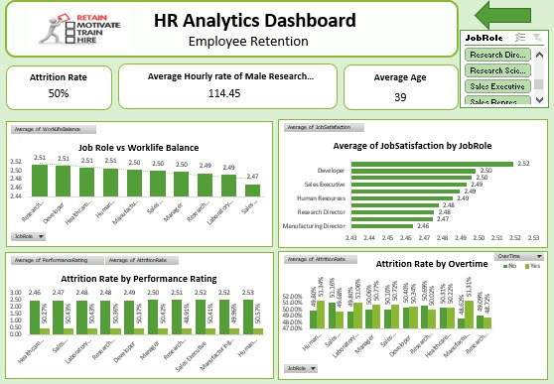

Slide 21
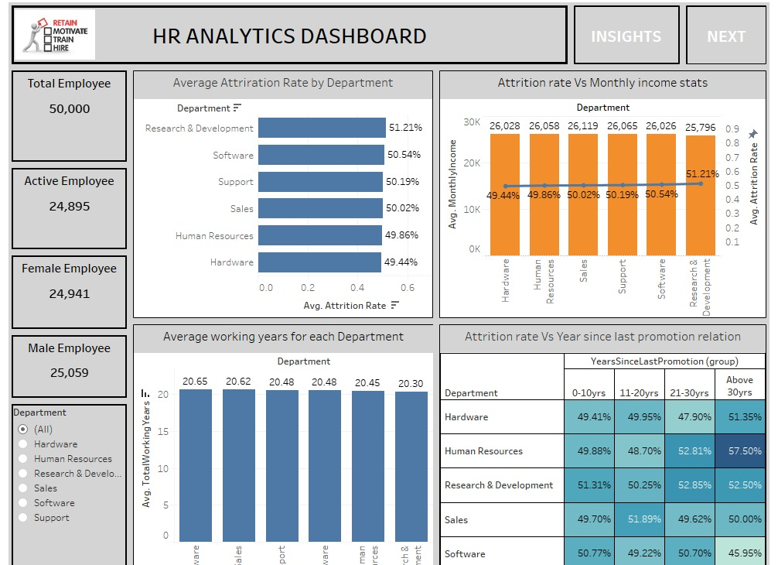

Slide 22
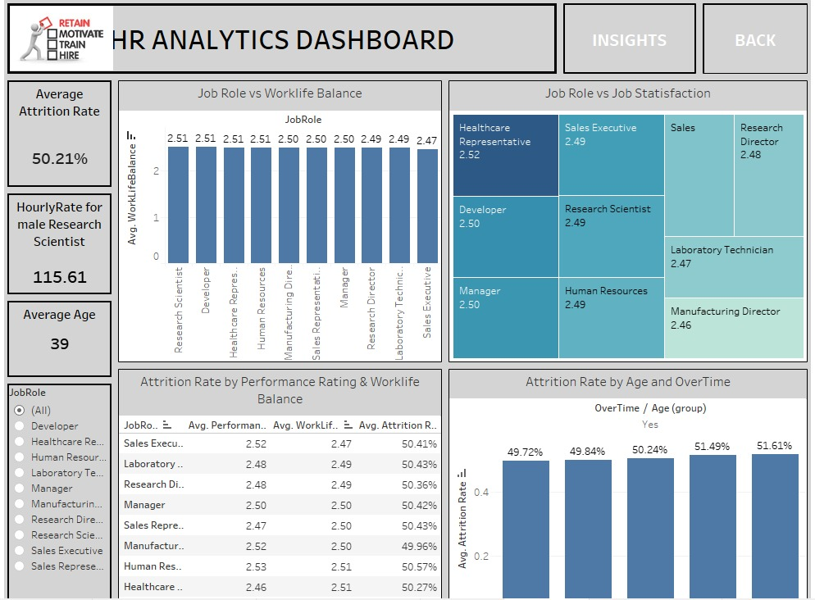

Slide 23
INSIGHTS
Overall attrition rate: Approximately 50%, not significantly dependent on departments.
Variations in attrition rates between departments: Hardware (49.44%), Research and Development (51.21%).
Influence of monthly income: Low average monthly income may contribute to higher attrition rates.
Impact of work-life balance: Research Scientists, Developers, Healthcare Representatives, and Human Resources roles have better work-life balance compared to Sales Executives.
Job satisfaction concerns: Manufacturing & Director roles exhibit lower job satisfaction, affecting attrition rates in these positions.
Performance rating and work-life balance: Employees with good performance ratings but lower work-life balance are at risk of leaving the company.

Slide 24
CONCLUSION
Pay employees competitively based on industry standards.
Introduce work-life balance initiatives like flexible schedules and support programs.
Recognize and develop employees' skills and career growth.
Communicate openly with employees.
Invest in employees' well-being and professional growth.
Talk to departing employees to understand their reasons for leaving.
Create retention plans based on employee feedback and concerns.

Slide 25
Thank You!

